Slide 1
PowerShell for the IT Professional
Part 1

Slide 2
Rotem Simhi
Email: Rotems@cio.gov.il
Course Content: \\tehila-fs\IT-SharedKB\PowerShell\PowerShell - Course Data

Slide 3
Who are you?
Name
Title/Function/Area of Responsibility
Product experience
Expectation for this Course

Slide 4
Agenda
Introduction
Commands
Pipeline
Commands 2
Scripts
Help
Object Models
Operators
Pipeline 2
Providers
Variables and Data Types
Operators 2
Data Structures
Flow Control
Scopes
Modules

Slide 5
Introduction
What is a Shell?
PowerShell Introduction
Command-Line Interface (CLI)
Scripting Language
Interactive Scripting Environment

Slide 6
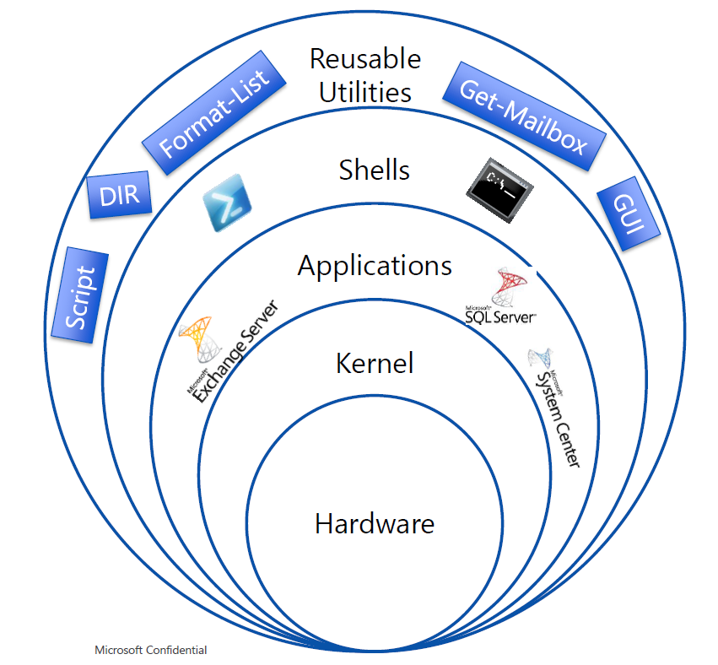
What is a Shell
Software enabling OS
and Application access
through interactive commands
or batches of commands (scripts)

Slide 7
Commands
External Commands
Cmdlet Syntax
Get-Command
Get-Help
Aliases

Slide 8
Cmdlet
Single purpose
Does not launch in a separate process
Native PS command
Verb-Noun naming
Used interactively, in piplines or in scripts
Parameters to control Cmdlet behaviour

Slide 9
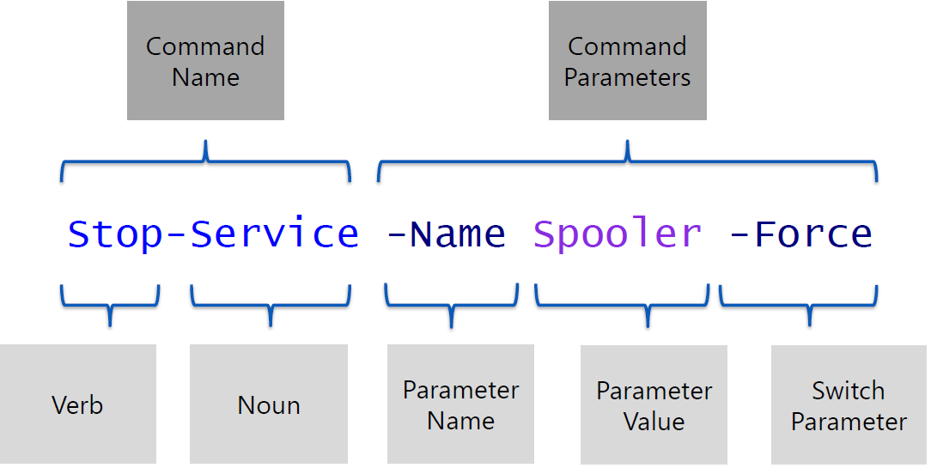
Anatomy of a Cmdlet

Slide 10
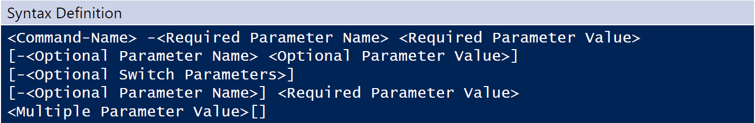
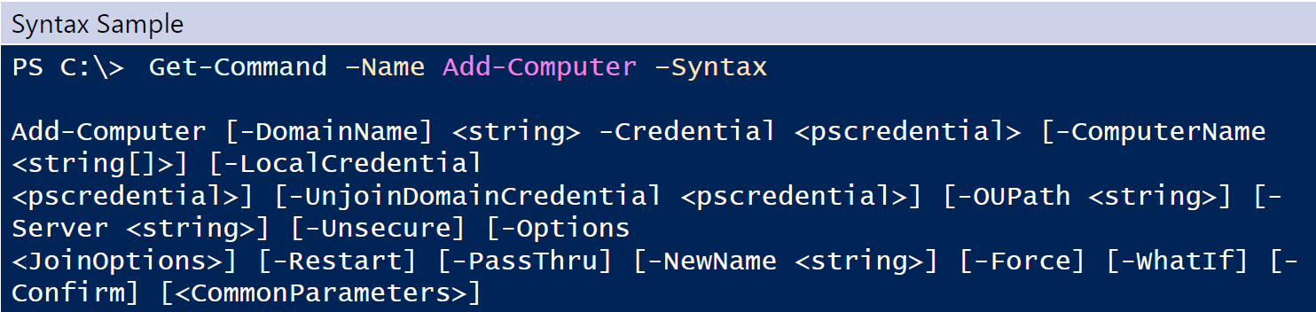
Syntax

Slide 11
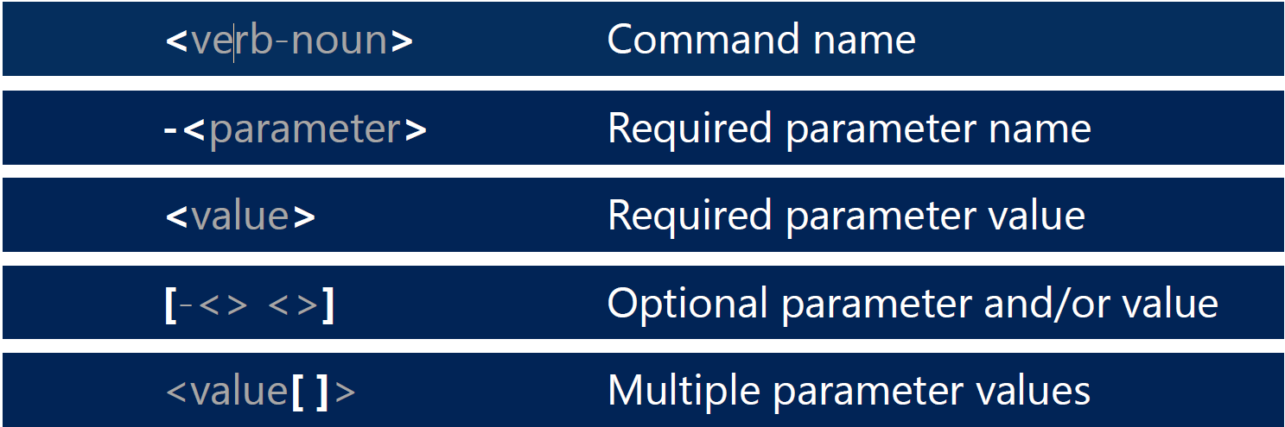
Syntax Legend

Slide 12
Common Parameters
Parameters automatically available with any Cmdlet
Implemented by PowerShell not Cmdlet developer
Override system defaults or preferences

Slide 13
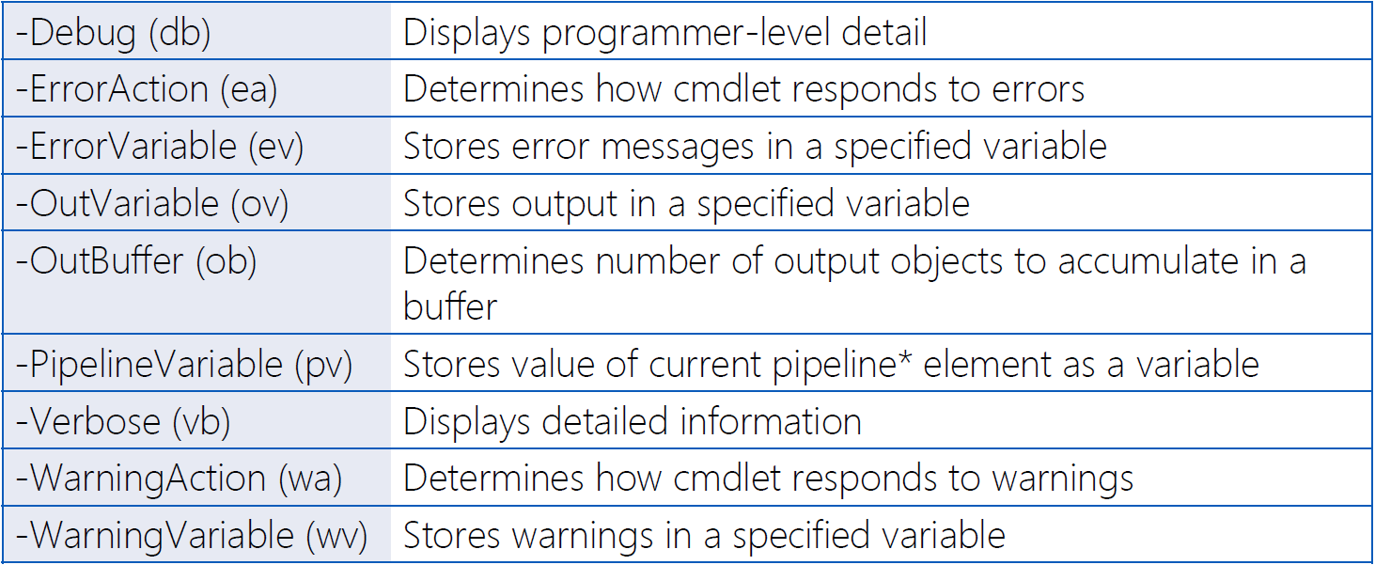
Common Parameters

Slide 14
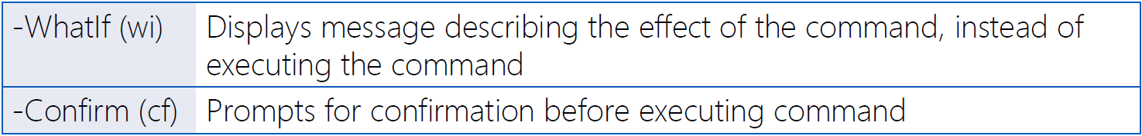
Risk Mitigation Parameters
Many cmdlets also offer risk mitigation parameters
Typically when the cmdlet changes the system or application

Slide 15
Core Cmdlets – Get-Command
Discover Commands (cmdlets, functions, scripts, aliases)
Can show command sytax
Can also discover external commands (.exe, .cpl, .msc)

Slide 16
Core Cmdlets – Get Help
Cmdlet help
Concept Help
Command Examples
Detailed Syntax

Slide 17
Pipeline
Pipeline Input
Pipeline Object Manipulation
Pipeline Output

Slide 18
Pipeline Input
Input from External Commands
Input from Cmdlets
Input from Text Files

Slide 19
Pipeline Object Manipulation
Sort-Object
Select-Object
Group-Object
Measure-Object
Compare-Object

Slide 20
Pipeline Output - Format
Format-List
Format-Table
Format-Wide

Slide 21
Pipeline Output – Export/Import
Export-Csv
Export-Clixml

Slide 22
Pipeline Output – Out Cmdlets
Out-Default
Out-File
Out-GridView
Out-Host
Out-Null
Out-String

Slide 23
Script Blocks

Slide 24
Functions

